Slide 1
The First Human Transporter
Craig Fleischman
Company Brown Bag
October 24, 2018
Notes:
Speaker: Craig Fleischman
Audience: Company Brown Bag
Armature: Living in an Echo Chamber is euphoric, until you must exit and enter the real world.
Welcome. My name is Craig Fleischman. I’m going to tell a story about the First Human Transporter.

Slide 2
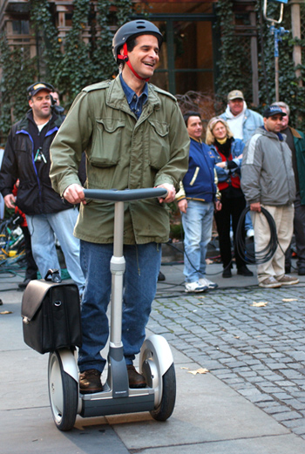
The First Human Transporter
Notes:
Speaker: Craig Fleischman
Audience: Company Brown Bag
Armature: Living in an Echo Chamber is euphoric, until you must exit and enter the real world.
Welcome. My name is Craig Fleischman. I’m going to tell a story about the First Human Transporter.

Slide 3
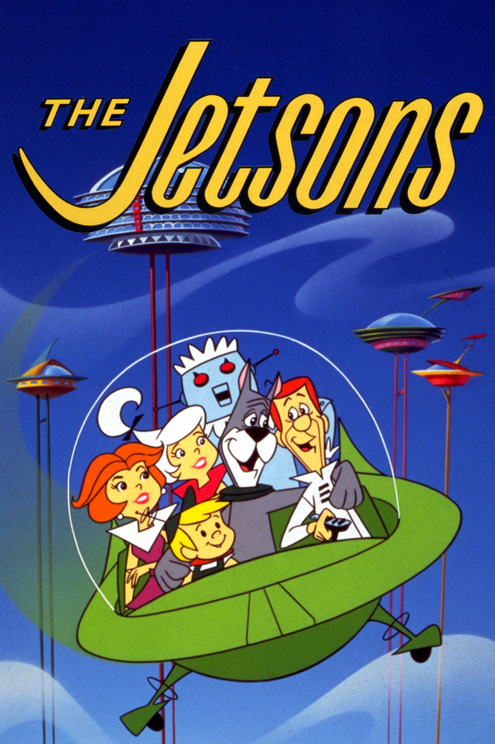
Once upon a time
Notes:
10 years in the works, a secret project that would change the global transportation industry was leaked to the public.
Dean Kamen, the creator of this unknown technology, was considered to be the next Thomas Edison. Kamen already had a series of high-profile inventions under his belt.
He created a dialysis machine,
A portable insulin pump,
And a wheelchair that climbs stairs.
The world-wide speculation reached a fever pitch in anticipation. Internet discussions, believed that the era of a Jetsons-like lifestyle was around the corner.

Slide 4
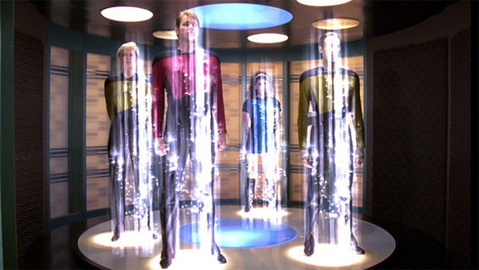

And every day…
Notes:
And every day
The vision of the new world was sold to everyone
Kamen hinted that the technology was closer to flying and that Cities would shrink to the point where cars "will not only be undesirable, but unnecessary."
The media frenzy — and the guessing game reached new levels of excitement as leaders who received an early sneak peak kept the frenzy going:
Apple co-founder Steve Jobs predicted that cities would be redesigned around the device and that it would be even more significant than the personal computer.
venture capitalist John Doerr predicted the company would be the fastest ever to reach $1 billion in sales.
Amazon founder Jeff Bezos said that the product is so revolutionary, you'll have no problem selling it.
Bob Metcalf, who helped to create the Internet said, "I've seen it, and it is […] more important than the Internet,"
Even South Park devoted an entire episode making fun of the unknown product prior to the release.
Kamen piled on even more and said, “it will be to the car, what the car, was to the horse and buggy.”

Slide 5
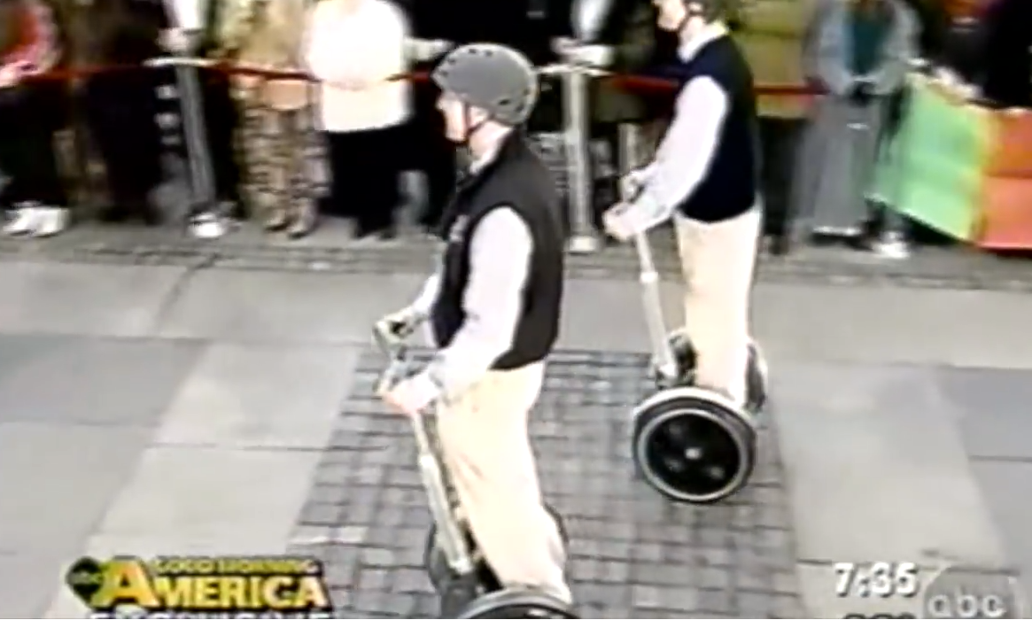
Until one day...
Notes:
After a year of speculation and a heightened public euphoria, in December 2001, Dean Kamen's mysterious machine was revealed live on ABC’s Good Morning America.
It was a Scooter. The Segway Personal Transporter, a two-wheeled, self-balancing scooter.
As Kamen demonstrated the device on live TV, he said, "You stand on this Segway Human Transporter and you think forward and you go forward, if you think backward, you go backward."
The factory was built capable of delivering 40,000 units/week
Amazon.com would be the only outlet where you could purchase the Segway.
The US Post office, FedEx, and countless local and state governments all lined up with future orders that would keep the factory at capacity.
The Printing Press, the Light bulb, the Internet and…. The Segway was ready to take its place in history.

Slide 6
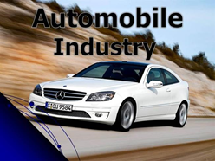

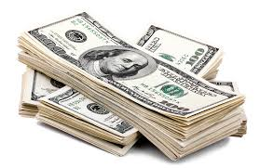
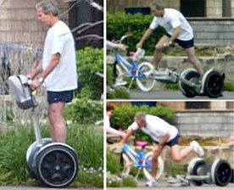

And because of this...
Notes:
Numerous events immediately followed the launch:
The Automobile industry began to lobby Congress heavily to stop the device from replacing cars.
The sticker shock of the $5000 Segway left most deciding that it could only be for the super wealthy.
The fear that haunted Kamen came true quickly.
George W. Bush was recorded falling off the Segway, which made worldwide news
But he wasn’t the last, more celebrities were getting injured and videos were seen regularly on the news.
Lawsuits began to mount.
Segway ended up recalling all of the personal transporter

Slide 7

And because of this...
Notes:
And because of this
Sales never materialized:
The largest corporate order was 4 dozen from Disneyland, all other orders by FedEx and others were cancelled.
Sales in the first year resulted in 6,000 units. Three years later they sold another 17,000 units
In the 7 years after launch, a total of 50,000 units were sold.
Unfortunately, most units produced were recalled.

Slide 8

Until finally...
Notes:
With Sales continuing to be minimal and media coverage regularly sharing accidents, for the next 5 years Segway was up for purchase.
Segway was sold to British millionaire James Heselden.
Before Heselden could turn the company around, he accidentally rode off a cliff to his death, … on a Segway.
Heselden’s estate sold the company to Summit Strategic Investments and then
Two years later sold Segway to a Chinese competitor; NineBot.

Slide 9



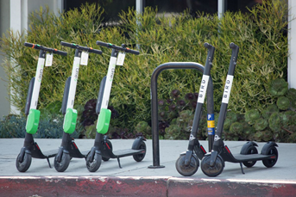
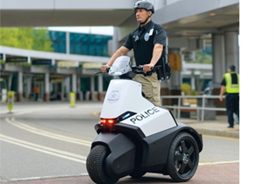

And ever since that day…
Notes:
And ever since that day
Segway blossomed under NineBot, branching out beyond the one product to 17 products in 4 categories - Professional, Consumer, Law Enforcement, and Industry Robots.
Today, Ninebot is capitalizing the international scooter craze, including the exploding ridesharing market.

Slide 10
Thank You
Notes:
This concludes my presentation. Thank you for your time. I will now open it up to Questions.
~~~~~~~~~~~~~~~~~~~~~~~~~~~~~~~~~~~~~~~~~~~~~
Where invisible Ink Helped:
Armature forced me to write down the point of the story and verify that everything made sense against it.
Removing unnecessary details that didn’t add to the story - especially around the data (it didn’t help the audience, it was for me :) ) *plus* extra sentences
Ensure that everything built upon each other
Where invisible Ink is challenged:
Predefined presentation outline
Trying to push the envelope on creativity → Bigger Risk and Bigger Reward (?)
I felt that there was a suggestion that everything in a book/movie was on purpose even if it was a failure. It seemed like if it worked, it was brilliant writing, and if it didn’t then a huge mistake -- hindsight is 20/20
Open Questions:
Given the information that is assumed common among screenwriters, why are there weak TV / Movie scripts?

Slide 11
References
https://www.wired.com/2009/12/1203segway-unveiled/
https://www.wired.com/2003/03/segway/
http://www.destination-innovation.com/why-did-the-segway-fail-some-innovation-lessons/
https://abcnews.go.com/Technology/story?id=98173&page=1
https://abcnews.go.com/GMA/story?id=126341&page=1
http://www.nbcnews.com/id/12990143/ns/business-us_business/t/segway-sets-course-stock-market/#.W863jmhKiUk
http://content.time.com/time/business/article/0,8599,186660,00.html
https://msu.edu/~luckie/segway/idea/idea.html
http://www.segway.com/products/consumer-lifestyle
https://www.dailymail.co.uk/news/article-479271/Ouch-The-moment-Piers-Morgan-broke-ribs-falling-Segway-said-idiot-proof.html
https://www.forbes.com/sites/briancaulfield/2010/09/27/steve-jobs-explains-why-were-not-all-riding-a-segway/#283f5ed15edb
http://www.ninebot.com/
Images outside of Articles:
Star Trek Next Generation
Jetsons: https://www.imdb.com/title/tt0055683/

